Slide 1
Learning Objective
I will be able to solve problems relating to normal distributions
Success Criteria
At the end of the lesson, I will be able to:
4.2.5 identify contexts, such as naturally occurring variation, that are suitable for modelling by normal random variables
4.2.6 identify features of the graph of the probability density function of the normal distribution with mean μ and standard deviation σ and the use of the standard normal distribution
4.2.7 calculate probabilities and quantiles associated with a given normal distribution using technology, and use these to solve practical problems

Slide 2
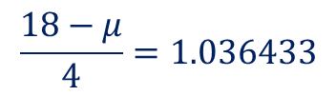



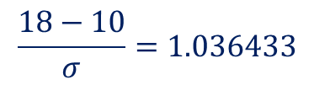
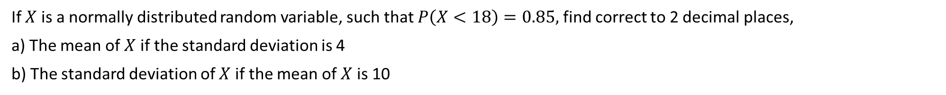
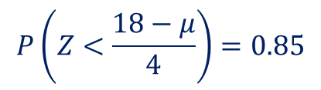
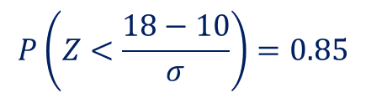




Guided Practice
If $X$ is a normally distributed random variable, such that $P\left(X<18\right)=0.85,$ find correct to 2 decimal places,
a) The mean of $X$ if the standard deviation is 4
b) The standard deviation of $X$ if the mean of $X$ is 10
$$X\sim N\left(μ, 4^{2}\right)$$
$P\left(X<18\right)=0.$85
$$X\sim N\left(10, σ^{2}\right)$$
Recall, changing to standard score we have: $Z=\frac{X−μ}{σ}$
$$P\left(Z<\frac{18−10}{σ}\right)=0.85$$
$$Z\sim N({0,1}^{2})$$
$$P\left(Z<\frac{18−μ}{4}\right)=0.85$$
$$\frac{18−10}{σ}=1.036433$$
$$\frac{18−μ}{4}=1.036433$$
$$σ=7.72$$
$$μ=13.85$$

Slide 3


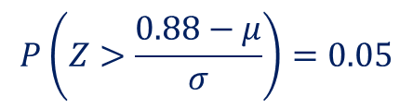

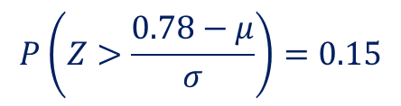


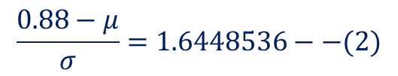

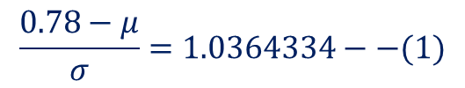
Guided Practice
The percentage marks of students sitting for a national science test were found to be normally distributed. Certificates of Distinction were awarded to 15% of the candidature for achieving a mark in excess of 78% and the top 5% of the candidature in addition to the Certificate of Distinction received a prized for achieving a mark in excess of 88%. Find the mean and standard deviation of the science marks, giving answers to one decimal place.
$$X\sim N\left(μ, σ^{2}\right)$$
$$P\left(X>0.78\right)=0.15$$
$$P\left(X>0.88\right)=0.05$$
Recall, changing to standard score we have: $Z=\frac{X−μ}{σ}$
$$Z\sim N({0,1}^{2})$$
$$P\left(Z>\frac{0.78−μ}{σ}\right)=0.15$$
$$P\left(Z>\frac{0.88−μ}{σ}\right)=0.05$$
$$\frac{0.78−μ}{σ}=1.0364334−−(1)$$
$$\frac{0.88−μ}{σ}=1.6448536−−(2)$$
Solving simultaneously,
$$μ=61.0\%, σ=16.4\%$$

Slide 4
Guided Practice
A company sells two types of batteries for travel clocks, type A and type B. Assume that both types are normally distributed.
A battery is considered ‘long-life’ if it lasts more than 948 minutes. The company claims that the mean life of type A batteries is 848 minutes with a standard deviation of 115 minutes.
What is the probability that a type A battery is ‘long-life’?
The company selects 20 type A batteries.
Find the probability that exactly 5 are ‘long-life’ batteries.
If the company is selecting the 20 type A batteries one at a time, find the probability that it takes the selection of 7 batteries before 5 ‘long-life’ batteries have been selected.
A survey of customers who purchased type B batteries showed that 24% of customers had batteries lasting less than 750 minutes and 8% had batteries lasting more than 960 minutes. Calculate the mean and standard deviation of type B batteries correct to 2 decimal places.
Find the value of c such that the probability of a battery lasting longer than c minutes is the same for both type A and type B batteries.

Slide 5
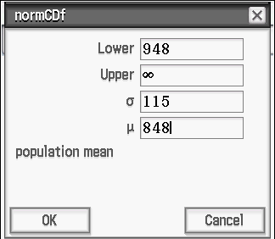

Guided Practice
A company sells two types of batteries for travel clocks, type A and type B. Assume that both types are normally distributed.
A battery is considered ‘long-life’ if it lasts more than 948 minutes. The company claims that the mean life of type A batteries is 848 minutes with a standard deviation of 115 minutes.
What is the probability that a type A battery is ‘long-life’?
$$A\sim N(848,{115}^{2})$$
$$P\left(A>948\right)=0.1923$$

Slide 6
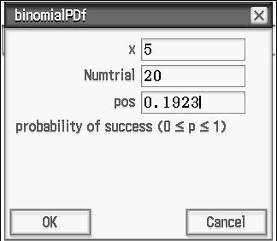

Guided Practice
A company sells two types of batteries for travel clocks, type A and type B. Assume that both types are normally distributed.
A battery is considered ‘long-life’ if it lasts more than 948 minutes. The company claims that the mean life of type A batteries is 848 minutes with a standard deviation of 115 minutes.
The company selects 20 type A batteries.
Find the probability that exactly 5 are ‘long-life’ batteries.
$$Y\sim Bin(20,0.1923)$$
$$P\left(Y=5\right)=0.1656$$

Slide 7

Guided Practice
A company sells two types of batteries for travel clocks, type A and type B. Assume that both types are normally distributed.
A battery is considered ‘long-life’ if it lasts more than 948 minutes. The company claims that the mean life of type A batteries is 848 minutes with a standard deviation of 115 minutes.
The company selects 20 type A batteries.
If the company is selecting the 20 type A batteries one at a time, find the probability that it takes the selection of 7 batteries before 5 ‘long-life’ batteries have been selected.
The last battery is the FIFTH long life battery
because it took a selection of 7 batteries to
reach FIVE long life batteries.
The remaining FOUR long life batteries
have been selected in any order among
the first six selections.
7 batteries are selected
$$Z\sim Bin(6, 0.1923)$$
$$P(Z=4)×0.1923$$
$$=0.01338×0.1923$$
$$=0.00257$$

Slide 8
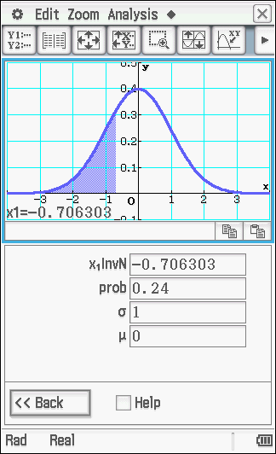
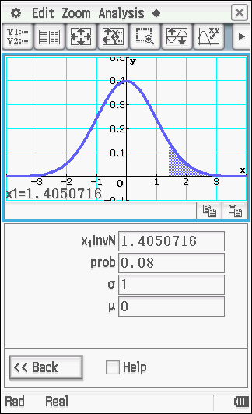
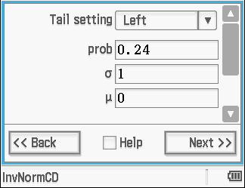
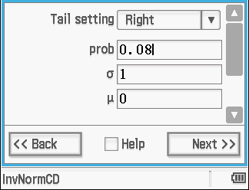

Guided Practice
A company sells two types of batteries for travel clocks, type A and type B. Assume that both types are normally distributed.
A survey of customers who purchased type B batteries showed that 24% of customers had batteries lasting less than 750 minutes and 8% had batteries lasting more than 960 minutes. Calculate the mean and standard deviation of type B batteries correct to 2 decimal places.
$$B\sim N(μ,σ^{2})$$
$$P\left(B<750\right)=0.24$$
$$P\left(B>960\right)=0.08$$
$$−0.7063=\frac{750−μ}{σ}$$
$$1.405=\frac{960−μ}{σ}$$
$μ=820.25$ and $σ=99.46$

Slide 9
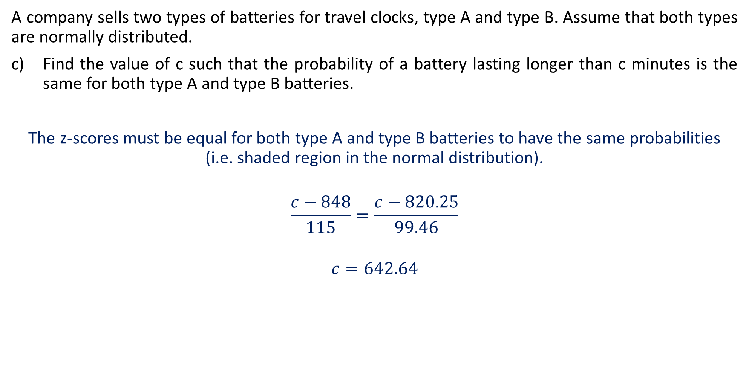
Guided Practice
A company sells two types of batteries for travel clocks, type A and type B. Assume that both types are normally distributed.
Find the value of c such that the probability of a battery lasting longer than c minutes is the same for both type A and type B batteries.
The z-scores must be equal for both type A and type B batteries to have the same probabilities (i.e. shaded region in the normal distribution).
$$\frac{c−848}{115}=\frac{c−820.25}{99.46}$$
$$c=642.64$$

Slide 10
Independent Practice
Complete Revision Sheet

